Slide 1

Database Lecture 4
Entity-Relationship Model,
Extended Features
Addendum
Dr. Jefferson Fong
Reference: 6.5.3, 6.8

Slide 2
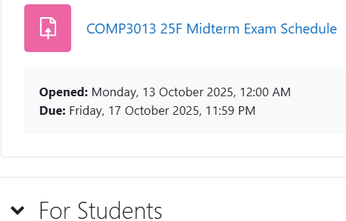
Announcements
Survey for Midterm date
Please take the survey in iSpace for possible time for Midterm.
  Survey closes on Fri Oct 17 right before midnight.
  If you don’t take the survey, you will forfeit your say on when the midterm should take place.
Project
Info will be released soon in iSpace.
  6 people in a team (?)

Slide 3
Note on Aggregation
Lecture 4 and Lab 5 both cover aggregation, but the meanings are different in the lecture and lab.
  In English, aggregation means “combine things together into a cluster”.
In Lecture 4, we combine entities-relationships together.
  We treat the combination as an abstract entity.
course
The abstract entity set
student
enroll
teach
instructor
In Lab 5, combine objects (such as films and actors) together and use aggregation functions such as count() and average() to study the group.

Slide 4
Aggregation (slides 3-8)
Slide 3
Last lecture, we learned how to convert ternary relationship into binary relationships to remove ambiguity in meaning.
  We used different binary architectures to handle Meaning 1 and Meaning 2.
  Suppose we want all the constraints from Meaning 1 and 2, as listed in the 3 constraints in Slide 3; then the architectures in last lecture won’t work.
We can use aggregation to solve this problem.
Slide 4
The stuff inside red box is an aggregation; we treat it like one entity.
Inside the box allows relationship between entities course and instructor.
Outside the box allows relationship between an entity (student) and a combination of multiple entities (course and instructor).

Slide 5
Aggregation (slides 3-8)
Slide 5
Form a 4-ary relationship by adding the entity project to the ternary relationship in Slide 3.
Slide 6
Problem: The original relationship enroll in Slide 3 (student and teacher enroll in a course) has a different meaning than the relationship between the 4 entities here.
  Diagram looks clumsy; not clear on relationships.
Slide 7-8 Use aggregation to remove redundancy.
  The aggregation is an abstract entity, having a relationship with entity project.
  Diagram in slide 8 much clearer than that in slide 6.

Slide 6
Weak Entity Sets, Slides 9-11
Slide 9
A weak entity can only exist depending on another entity.
(Do Slide 10 before doing the rest of Slide 9 and 11 together
Slide 9 definitions with Slide 11 example E-R diagram
  The weak entity section (double rectangle) can only exist with the identifying entity course.
  A weak entity set consists of all sections of a course.
  Participation of section in the identifying relationship (double diamond) course_section is total (double line); i.e. every section must depend on a course.

Slide 7
Weak Entity Sets, Slides 9-11
Slide 9 definitions with Slide 11 example E-R diagram (continue)
  There’s a one-to-many relationship between identifying entity to weak entity, i.e. one course has many sections.
  The discriminator (or partial key) is section_num (dashed underline).
  Let course_name (not shown in the diagram) be the key of the entity course. To distinguish weak entities (different sections of a course), we must combine course_name with section_num, e.g. DBMS section 2.

Slide 8
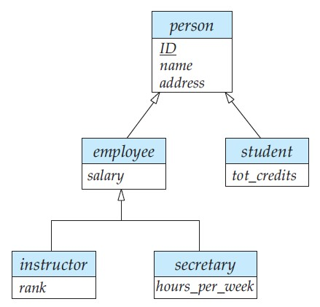
Generalization and Specialization (Slides 12-15)
Specialization
Top-down approach, similar to Java inheritance
  Start with a high level general entity.
  Then specialize (add attributes) to child entities.
Specialization
Generalization
Bottom-up approach
  Start with low level entities, then create more general entity.
  “Which attributes are common among these low level entities?”
  Put the common entities into a higher level entity.
You learned this in OOP. Same idea applies to entities.

Slide 9
Generalization and Specialization (Slides 12-15)
Slide 12-13
Generalization – create a super set entity called person to hold all the common attributes between student and instructor entity.
  In ER diagram, person is a super set entity of entities student and instructor.
  In OOP, person is a super class of student class and instructor class.
Slide 14
The ISA triangle is similar to the class diagram symbol in Java.
  (Except the arrow points to the opposite direction.)

Slide 10
Generalization and Specialization (Slides 12-15)
Slide 16
Recall last lecture cardinality constraints (how many) and participation constraints (total or partial).
In ISA,
  Don’t bother to put in double lines in lower level.
    Lower level entities are always fully participating; see ISA in Slide 14.
  We only consider two types of constraints: total generalization and disjoint generalization.

Slide 11
Constraints on Generalization / Specialization
Slide 17
Total generalization are for full participation
  Every person must be either a student or instructor.
  There is a double line between person entity and ISA triangle.
  The double line is colored in red in this diagram, but usually it’s not colored.
Disjoint generalization
  The two “child” entities student and instructor are disjoint.
  A person cannot be both student and instructor.
  Write “disjoint” underneath the ISA triangle (not necessarily in red).

Slide 12
Summary of ER Diagram Design
Modeling
Constraints
ER Model
Weak Entity
Extended
Design Issue
Design Tech
Practice
To Schema
E
entity set
R
relationship set
A
attribute
E
weak entity set
R
identifying
relationship set
A
multivalued
attribute
R
E
total
participation
many-to-many
relationship
A
derived
attribute
R
R
1..h
E
cardinality
limits
R
many-to-one
relationship
A
primary key
R
role
name
E
role
indicator
one-to-one
relationship
A
R
discriminator
ISA
ISA
ISA
total
generalization
ISA
disjoint
generalization
disjoint

Slide 13
Exercises
Slide 19 is the solution to last week’s exercise.
Slide 18
Add weak entity section – see Slide 11
Generalize “student” and “instructor” – see Slide 17
Add “semester” and “section number” (partial key) to section.

Slide 14
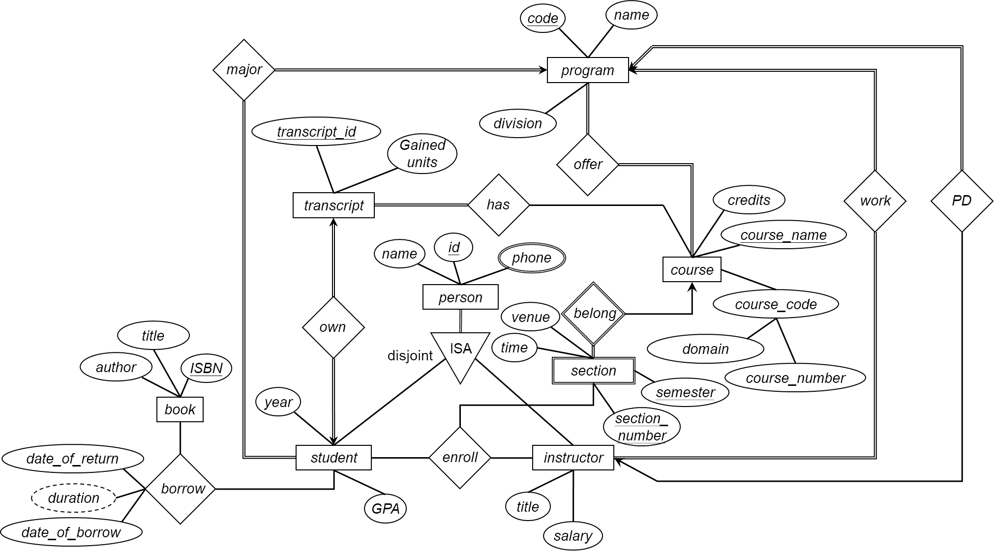

Slide 15
Lecture the intro to Lab 5.
  Up to Slide 3 of Lab 5, Slide 5 of addendum.
  If not for long holiday, should lecture up to Slide 7 examples.
Long break before doing the lab after National Holiday.
After National Holiday but before Lab 5, you need to review the Lab 5 and Lab 5 addendum slides.

